Slide 1
Digital Portfolio
STUDENT NAME: THRISHA.S
REGISTER NO AND NMID: 27DF2EF2C918CEAB7AB4E3F64F435266
DEPARTMENT: B.sc, COMPUTER SCIENCE
COLLEGE: Sri Akilandeswari Women’s College-Wandiwash
UNIVERSITY : Thiruvalluvar University

Slide 2
PROJECT TITLE
STUDENT DIGITAL PORTFOLIO
USING FRONT-END DEVELOPMENT

Slide 3


AGENDA
Problem Statement
Project Overview
End Users
Tools and Technologies
Portfolio design and Layout
Features and Functionality
Results and Screenshots
Conclusion
Github Link

Slide 4

PROBLEM STATEMENT
In today's digital era, one needs to project one's skills, accomplishments, and projects for academic, personal, and professional development. Conventional resumes cannot encompass creativity, interactivity, and ongoing learning. Thus, there is a requirement for a digital portfolio that is an interactive resume and enables students and professionals to represent themselves well.

Slide 5

PROJECT OVERVIEW
This is a Student Digital Portfolio Website that has been created with HTML, CSS, and JavaScript. It showcases personal information, abilities, academic work, and interests, and provides a contact form for simple communication. It is completely responsive and easy to use.

Slide 6

WHO ARE THE END USERS?
Students – to exhibit skills, projects, and accomplishments.
Recruiters/Employers – to assess student skills and experience.
Teachers/Mentors – to monitor and review student portfolios.
General Audience – to discover student projects and imagination

Slide 7

TOOLS AND TECHNIQUES
Frontend:
HTML – for structuring the content
CSS – for adding style
JavaScript – for added to interactivity
Editor Tool: Visual Studio Code
Version Control: Git and GitHub
Browser: Chrome, Edge, Firefox for testing projects and ideas

Slide 8
POTFOLIO DESIGN AND LAYOUT
Header/Hero Section – Name and Title introduction.
Navigation Bar – Seamless transition to every section.
About Section – Background and career objectives.
Skills Section – Shows technical and soft skills through skill tags.
Projects Section – Lists completed work with descriptions.
Contact Section – Interactive form for contacting.
Footer – Copyright information
8

Slide 9
FEATURES AND FUNCTIONALITY
✔ Responsive design (desktop, tablet, mobile compatible)
✔ Clean and minimal user interface
✔ Interactive navigation bar
✔ Tag-style design highlighting skills
✔ Project cards with demo/resource link
✔ Contact form validated through JavaScript
✔ Easy to extend and customize
9

Slide 10

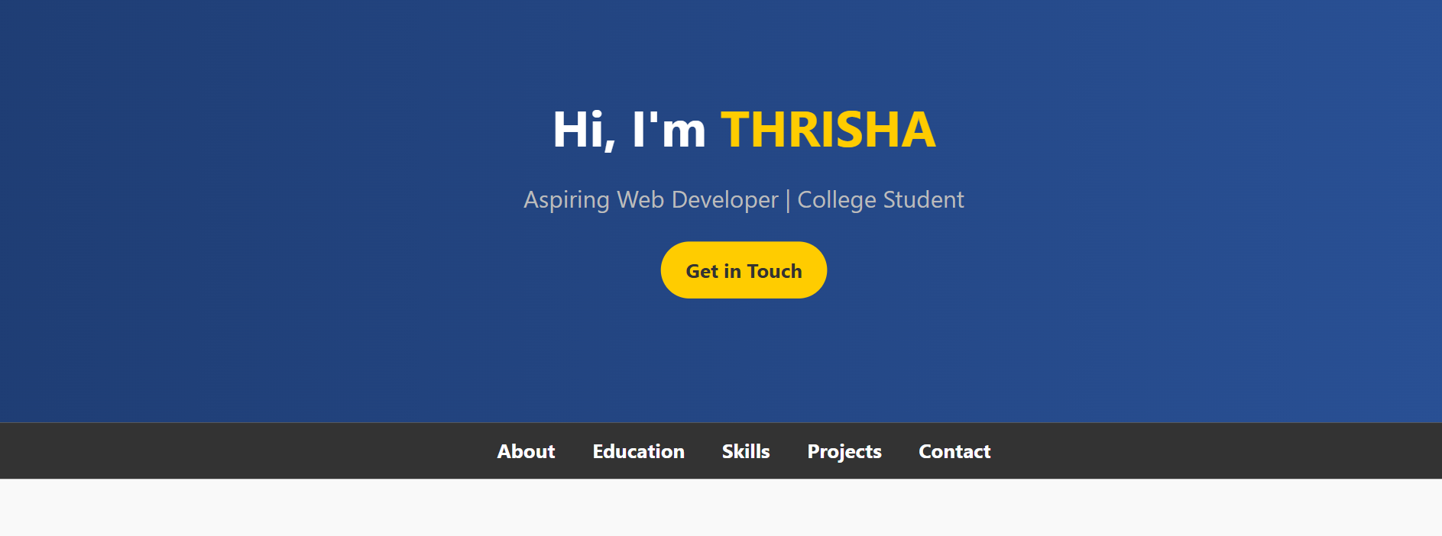
RESULTS AND SCREENSHOTS
The portfolio loads quickly and adjusts to different screen sizes.
Screenshots are attached here (Home page, Skills page, Projects, Contact form).
10

Slide 11
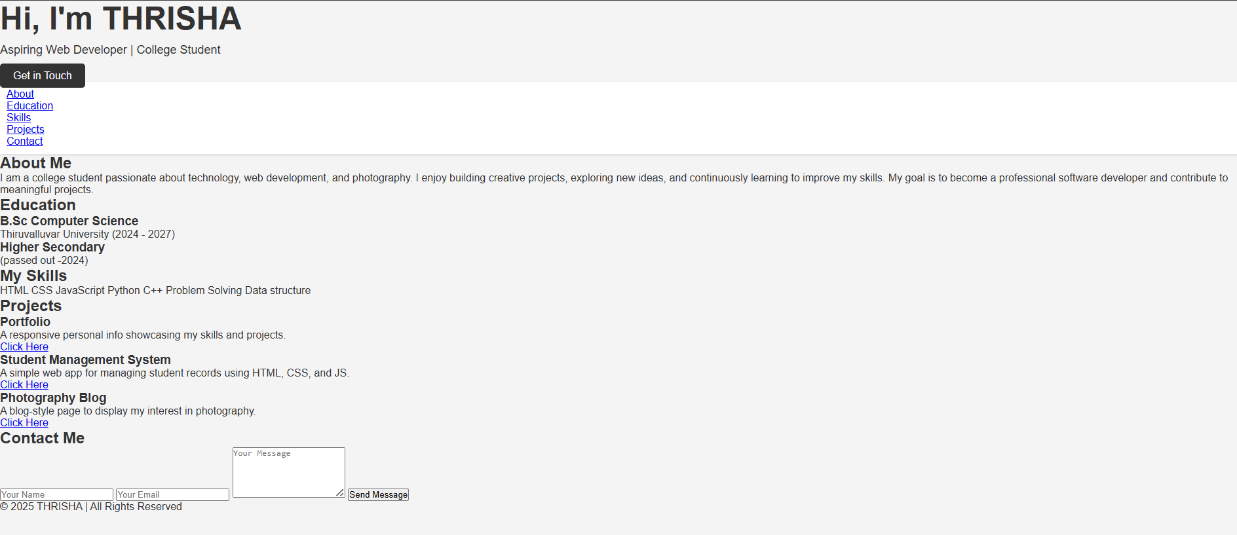
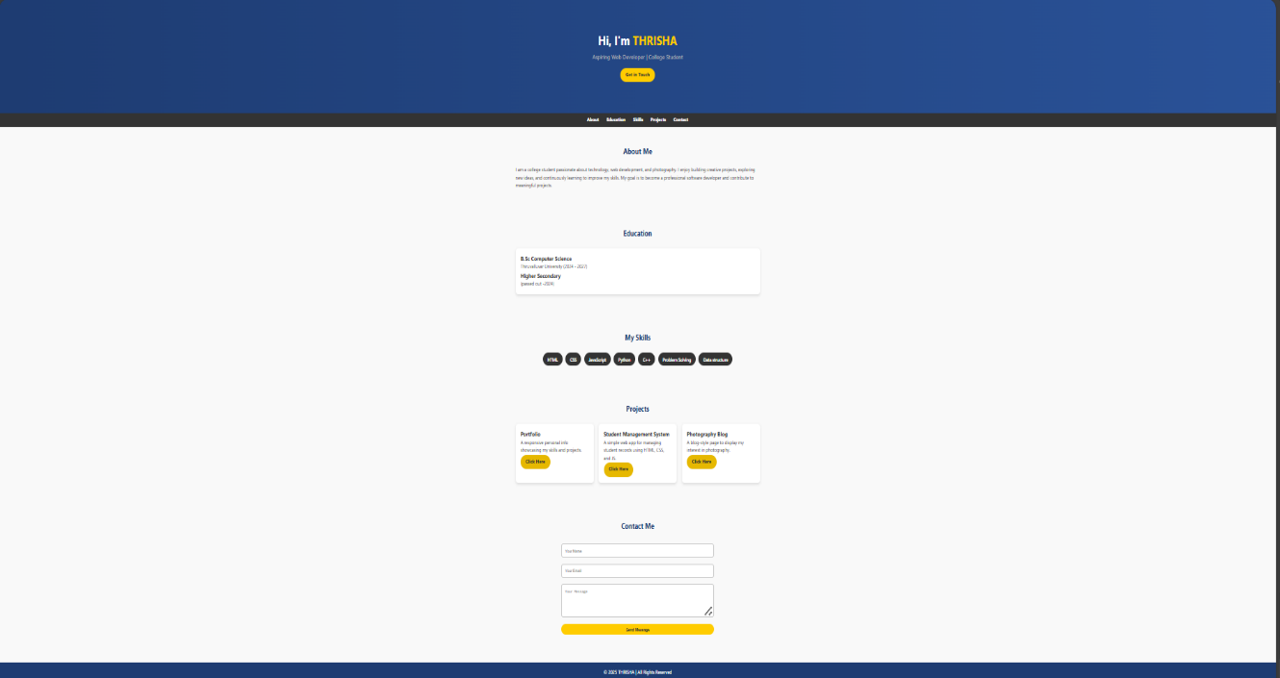
Before adding CSS and JAVASCRIPT
After adding CSS and JAVASCRIPT
11

Slide 12
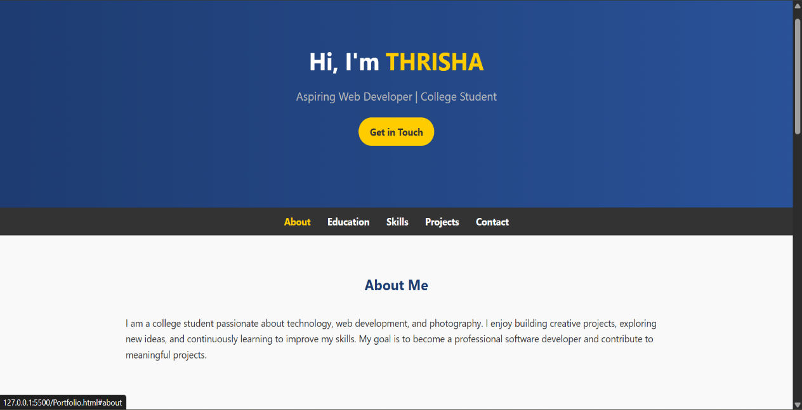
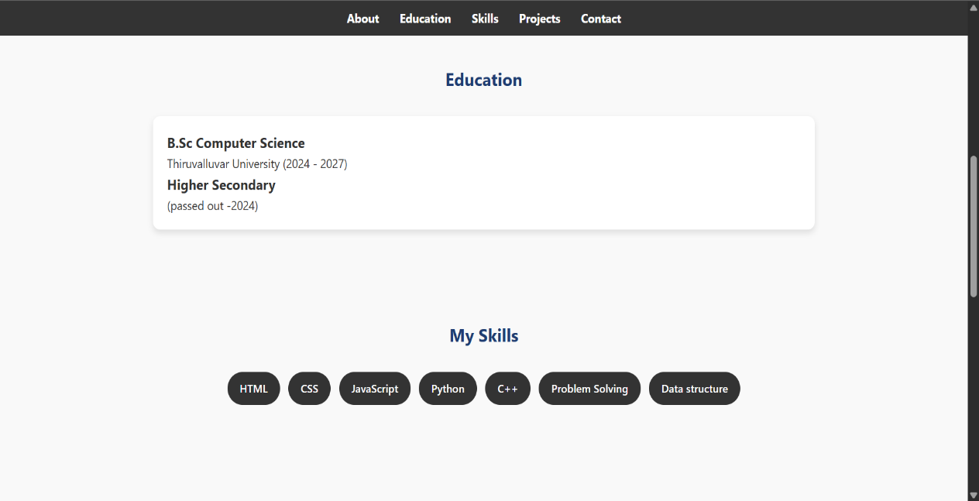
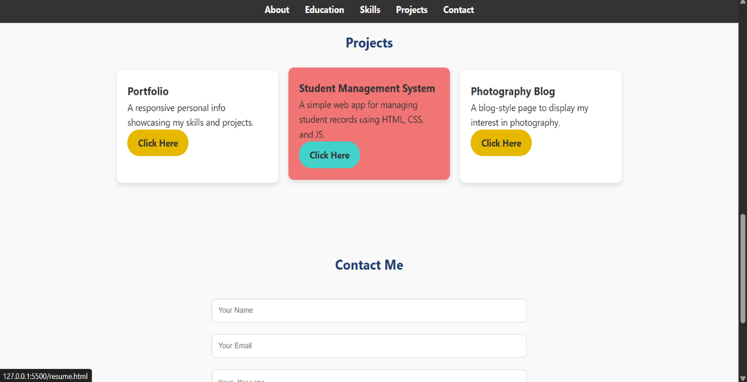
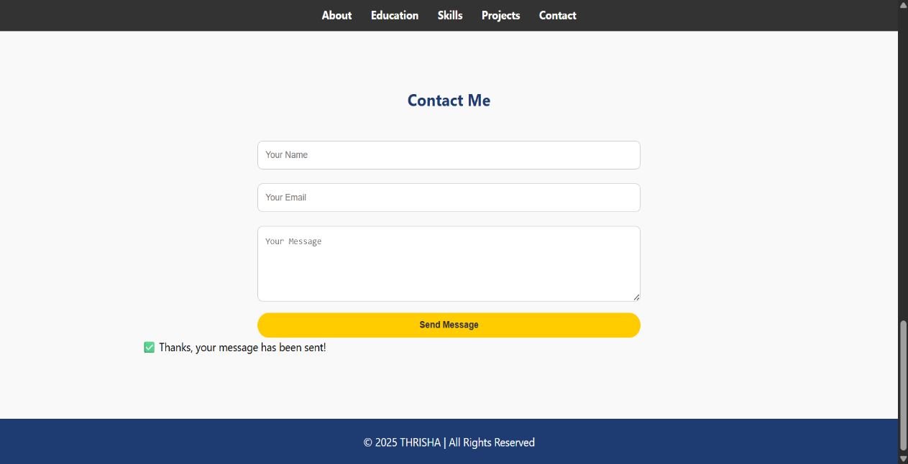
12

Slide 13
CONCLUSION
This digital portfolio effectively illustrates the ways in which a student can present academic and personal accomplishments in an interactive, professional setting. It offers a solid base for further enhancements like including a blog, backend storage, or advanced frameworks such as React.
13

Slide 14
GITHUB
https://github.com/Thrishasivakumar/TNSDC-FWD-Digitalportfolio.git
14

Slide 15

Thank you ☺
15

